Slide 1
KV Cache method for accelerating LLM inference
Faculty of Computer Science
Moscow 2026

Slide 2
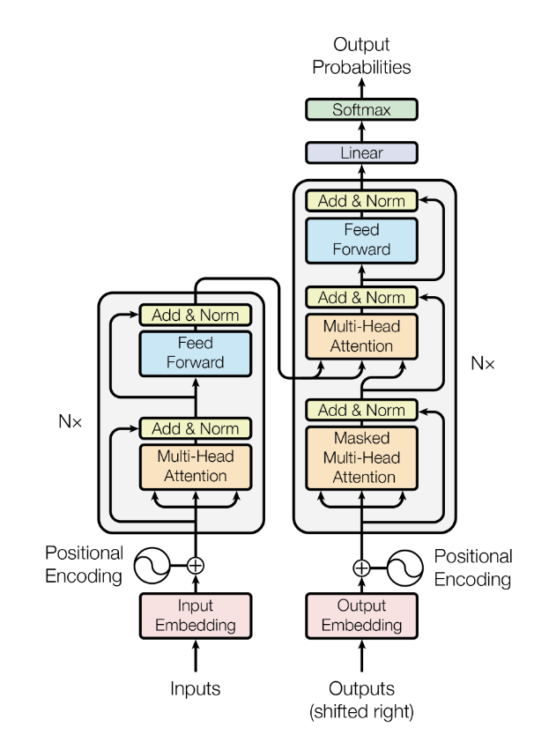
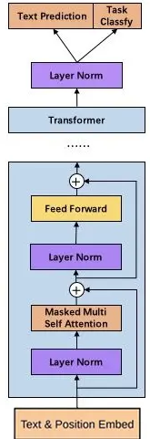
Basic Structure of Large Language Models
From GPT-2
Modern large language models separate the decoder part from the original transformer architecture and remove the red cross-attention part in the middle.

Slide 3

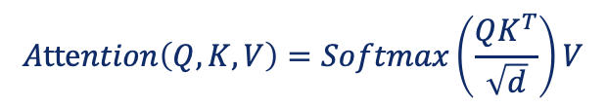


Self-Attention Mechanism
$$Attention\left(Q,K,V\right)=Softmax\left(\frac{QK^{T}}{\sqrt{d}}\right)V$$
Q
v
K
Attention Matrix
@
=
@
$$W_{Q}$$
$$W_{K}$$
$$W_{V}$$
Input Data Hidden Representation
Tokenization, Positional Encoding, Normalization
Prompt: HSE University is the most internationalized university in the Russian Federation.

Slide 4


LLM Inference Process Without KV Cache
User input:
Q
$$K^{T}$$
(Round 0)
HSE University is
HSE
Model Output：
University
@
is
University
(Round 1)
HSE University is the
HSE
is
(Round 2)
HSE University is the most
(Round 3)
HSE University is the most internationalized
(Round 4)
HSE University is the most internationalized university
HSE
/HSE
mask
mask
(Round 5)
HSE University is the most internationalized university in
V
(Round 6)
HSE University is the most internationalized university in the
(Round 7)
HSE University is the most internationalized university in the Russian
University/HSE
University/University
mask
HSE
(Round 8)
HSE University is the most internationalized university in the Russian Federation
=
@
University
(Round 9)
HSE University is the most internationalized university in the Russian Federation.
is
is/HSE
is/University
is/is
University
=
is
the

Slide 5



LLM Inference Process Without KV Cache
HSE University is the most internationalized university in the Russian Federation.
1 2 3 4 5 6 7 8 9 10 11 12
Q
$$K$$
$${QK}^{T}$$
$$V$$
1)
HSE University
HSE
HSE
@
=
HSE/HSE
@
=
HSE
University
2)
HSE University is
HSE
1/1
mask
HSE
University
@
=
@
University
=
HSE
University
University
2/1
2/2
is
1/1
mask
mask
3)
HSE University is the
HSE
HSE
University
2/1
2/2
mask
University
University
is
@
=
@
is
=
is
HSE
University
is
the
3/1
3/2
3/3

Slide 6
LLM Inference Process With KV Cache
HSE University is the most internationalized university in the Russian Federation.
1 2 3 4 5 6 7 8 9 10 11 12
Q
$$K$$
$${QK}^{T}$$
$$V$$
1)
HSE University
HSE
HSE
@
=
HSE/HSE
@
=
HSE
University
2)
HSE University is
University
1/1
mask
HSE
@
=
@
University
=
HSE
is
University
2/1
2/2
1/1
mask
mask
3)
HSE University is the
HSE
is
2/1
2/2
mask
@
University
@
=
is
=
the
HSE
University
is
3/1
3/2
3/3

Slide 7
KV Cache Example (Multi Turn Conversations)
Turn 1 (Q)
Turn 1 (A)
There are a total of 4 generate requests.
The blue boxes indicate shareable hints.
Chat History
Turn 2 (Q)
Turn 2 (A)
Chat History
Turn 3 (Q)
Turn 3 (A)
Chat History
Turn 4 (Q)
Turn 4 (A)
With KV Cache:
Memory consumption (KV Cache in memory):
😭
Memory consumption increases linearly.
2*batch*context_length*n_layers*n_heads*d_head*Pa
4 bytes/parameter in full-precision (FP32), 2bytes/parameter in half-precision (BF16, FP16), 1 byte/parameter for 8 bit
😁
Reduced matrix computation complexity.

Slide 8

KV Cache Example (Llama-7B)
A prompt for 1000 tokens is approximately:
~500MB memory
~14TFLOPs of compute
Llama-7B
In a forward-propagating process:
~0.5 MB/token of GPU memory
~14 GFLOPS/token of GPU compute
Assuming in the NVIDIA A10 GPU:
Loading this 7B model requires 14GB of GPU memory.
The remaining 10GB of GPU memory supports a maximum KV cache window of approximately 20K.
10K prompt inference time test:
With KV Cache: 11 seconds
Without KV Cache: 56 seconds

Slide 9
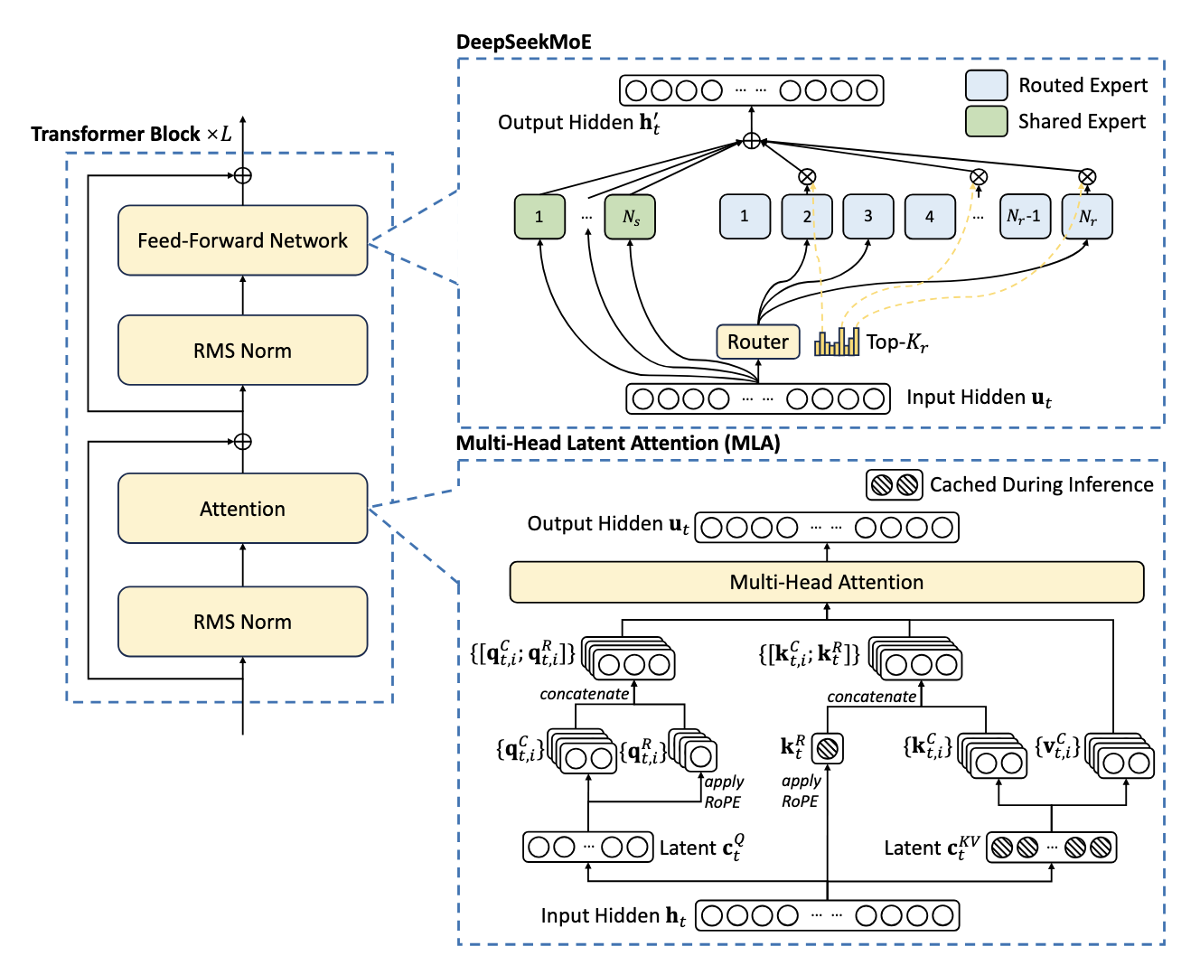
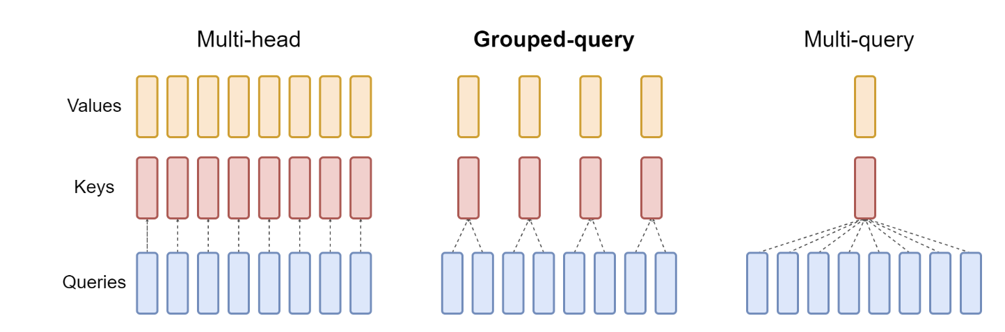
Direction 1 - Architecture-Level KV Reduction
Change the attention architecture so the model stores fewer or smaller K/V tensors.
MHA
Many KV heads
MQA
1 KV head
GQA
Grouped KV heads
MLA
Latent KV state
Future
Hybrid designs
This direction usually requires architecture choice during training or conversion/uptraining from an existing checkpoint.

Slide 10
Direction 2 - KV Cache Quantization
Keep the same tokens and layers, but store K/V with fewer bits.
FP16/BF16 KV
16 bits per value
INT8 / INT4 / 2-bit KV
smaller cache
Dequantize / use directly
in attention kernels
Method
Core idea
What to emphasize in a talk
KVQuant
Outlier-aware quantization for KV cache.
Accuracy-preserving low-bit KV cache.
MiniKV / MiniCache
Very low-bit or layer-aware cache compression.
Pushes toward 2-bit or smaller regimes.
LeanKV
Unified quantization + sparsity with per-head budgets.
Combines quantization and pruning in a serving framework.
CacheGen
Encode KV tensors into compact bitstreams for transfer/reuse.
Useful when cached context must be fetched over network/storage.
TurboQuant
Training-free polar transform + QJL residual correction.
Recent low-bit KV compression direction.
KVTC
PCA/decorrelation + adaptive quantization + entropy coding.
Treats reusable KV cache like a compressible signal.

Slide 11
Direction 2 - KV Cache Quantization
KIVI is a representative plug-and-play quantization method.
Key cache
quantize per-channel
Value cache
quantize per-token
Motivation
K and V have different distributions
Observation: key cache often has outliers along channels, so per-channel grouping is better.
Observation: value cache is better handled with per-token grouping.
Method: 2-bit asymmetric quantization without fine-tuning.
Practical value: lower memory footprint can allow larger batch size and higher throughput.

Slide 12
Direction 3 - KV Cache Reuse
Basic KV cache = reuse K/V within one request.
KV cache reuse methods = reuse precomputed K/V across turns, prompts, requests, engines, or even adapters.
System prompt
RAG document
Multi-turn chat
Code editing
Shared prefix
Reusable context
Repeated history
Large unchanged file
Goal: reduce prefill cost and time-to-first-token when prompts overlap.
Main constraint: K/V cache is position-sensitive, model-specific, and memory-heavy.
Serving systems must handle lookup, validation, routing, eviction, transfer, and security isolation.

Slide 13
Direction 3 - KV Cache Reuse
Prefix Caching and Prompt Cache
Reuse is easiest when the new request shares the same prefix or explicitly defined prompt modules.
Request A
[System][Policy][Doc][Question A]
Reusable prefix
[System][Policy][Doc]
Skip repeated prefill
load cached K/V blocks
Request B
[System][Policy][Doc][Question B]
Method name
Reuse unit
Key idea
Automatic Prefix Caching
Identical prefix blocks
Hash processed KV blocks and reuse when a new request shares the prefix.
Prompt Cache
Prompt modules
Define reusable text segments and precompute attention states for them.
KVLink
Retrieved context segments
Reuse precomputed KV caches for retrieved documents or overlapping contexts.

Slide 14
Direction 3 - KV Cache Reuse
System-Level KV Cache Reuse
Real serving requires moving and managing cache blocks across hardware and requests.
GPU HBM
fast but scarce
CPU DRAM
larger but slower
SSD / Object store
huge but I/O-bound
Other engine
prefill/decode split
Method / system
What it adds
CacheGen
Compress and stream KV cache for fast context loading.
LMCache
Store, move, and reuse KV caches across engines, queries, and memory tiers.
TensorRT-LLM KV cache reuse
Share cache pages for requests starting with the same prompt.
vLLM Automatic Prefix Caching
Hash-based block reuse for shared prefixes.

Slide 15
Direction 4 - Cross-Layer Sharing
Instead of storing K/V independently for every layer, reuse or reconstruct them across layers.
Layer 1
K/V
Layer 1
K/V
Layer 2
K/V
Layer 2
K/V
Reuse / reconstruct
for later layers
Layer 3
K/V
Layer 3
K/V
Layer 4
K/V
Layer 4
K/V
Layer 5
K/V
Layer 5
K/V
Naive: every layer stores its own K/V
Cross-layer sharing: exploit similarity/redundancy between layers
Potential benefit: reduce cache by sharing, reusing, or reconstructing layer K/V tensors.
Challenge: deeper layers have different representations; naive sharing can hurt quality.
Often requires architecture design, training, fine-tuning, or careful layer alignment.

Slide 16
Direction 4 - Cross-Layer Sharing
Method
Core idea
Best interpretation
YOCO - You Only Cache Once
Self-decoder creates global KV cache; cross-decoder reuses it via cross-attention.
Architecture-level cross-layer reuse.
CLA - Cross-Layer Attention
Share K/V cache across multiple decoder layers.
Cache fewer layers instead of all layers.
KVSharer
Plug-and-play layer-wise KV cache sharing.
Exploit inter-layer redundancy.
MiniCache
Compress KV cache by merging similar layer states.
Layer redundancy compression.
KVALIGN
Identify similar neighboring layers and align consumer layers by distillation.
Adapt pretrained models for inter-layer sharing.
KV-CAR
Autoencoder compression plus similarity-driven KV reuse across adjacent layers.
Architecture-agnostic compression + reuse.
Cross-layer sharing is different from prefix reuse. Prefix reuse shares across requests; cross-layer sharing shares within the model depth.

Slide 17
Direction 5 - Pruning / Eviction
Pruning reduces the number of cached tokens or blocks rather than the precision of each value.
t1
t2
t3
t4
t5
t6
t7
t8
t9
t10
t11
t12
Keep recent + important tokens; evict low-utility entries.
Recent window
Heavy hitters
Attention sinks
Per-head budgets
Token-level pruning: remove individual K/V positions.
Block-level pruning: evict page/block units to match serving-system memory managers.
Dynamic eviction: update importance as generation progresses.
Main risk: deleting a token that becomes important later.

Slide 18
Direction 5 - Pruning / Eviction
H₂O: Heavy-Hitter Oracle
H₂O keeps a small set of high-impact tokens plus recent tokens.
Attention history
accumulated scores
Identify heavy hitters
small set contributes most attention value
Retain heavy hitters
+ recent window
Method name: H₂O / Heavy-Hitter Oracle.
Observation: a small portion of tokens receives most of the attention mass.
Eviction policy: dynamically balance important historical tokens and recent tokens.
Useful explanation: it turns cache selection into an online token-retention problem.

Slide 19
Direction 5 - Pruning / Eviction
StreamingLLM: Attention Sinks + Sliding Window
StreamingLLM shows why “only keep recent tokens” is not always enough.
sink 1
sink 2
old
old
old
recent
recent
new
Keep initial sink tokens + a sliding recent window; discard the middle.
Attention sink: initial tokens can receive high attention even if not semantically important.
Pure sliding-window attention can fail when the sequence is longer than the cache size.
StreamingLLM keeps sink tokens and a recent window to enable stable long streaming.
It is best explained as bounded-memory inference for very long conversations/streams.

Slide 20
Direction 5 - Pruning / Eviction
SnapKV, PyramidKV, Ada-KV, Keyformer
Later pruning methods refine how importance and budget are estimated.
Method
Selection / budget idea
How to explain it
SnapKV
Uses an observation window near the end of the prompt to vote for important prefix positions.
Predict important KV positions before generation.
PyramidKV
Assigns different cache budgets across layers in a pyramid-like pattern.
Layer-wise cache budget is not uniform.
Ada-KV
Allocates budgets adaptively across attention heads.
Different heads need different cache sizes.
Keyformer
Selects key tokens and uses regularization / scoring for token retention.
Token selection as approximate attention preservation.
PagedEviction
Evicts structured blocks aligned with paged serving systems.
Make pruning compatible with vLLM-style block memory.
Pruning is no longer only “drop low attention tokens”; current work studies per-head, per-layer, block-level, and serving-system-aware eviction.

Slide 21
Method Comparison Matrix
Direction
Changes model?
Reduces memory?
Improves speed?
Risk / cost
MHA→MQA/GQA/MLA
Yes / architecture or conversion
High
High in decode
Training/conversion; quality trade-off
Quantization
Usually no
Medium to high
High if kernels are efficient
Numerical error; dequant overhead
KV cache reuse
No, mostly system-level
Avoids recomputation; may increase stored cache
High for repeated prompts
Position/model match; security; routing
Cross-layer sharing
Often yes or fine-tuning
Medium to high
Medium
Layer mismatch; adaptation cost
Pruning / eviction
Usually no
High
Medium to high
May drop future-important tokens

Slide 22
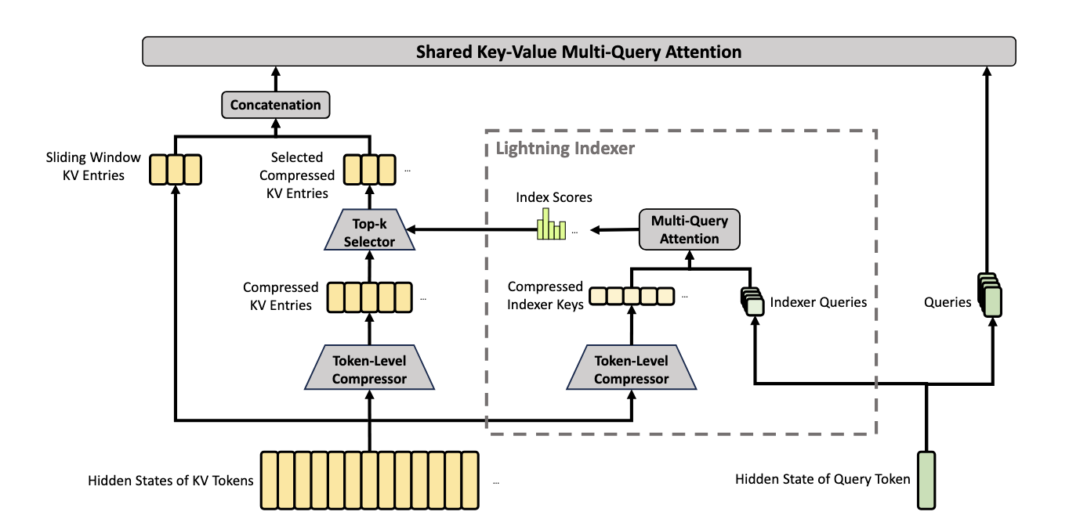
Other insights come from DeepSeek V4
Since the Key Value Cache is generated from the input prompt, can we reduce the storage pressure on the key-value cache by compressing the length of the prompt?

